Slide 1
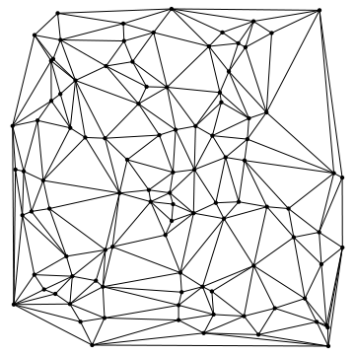
Interactive Delaunay Triangulation
Stephen Ranger

Slide 2
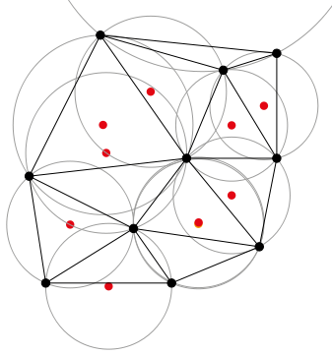
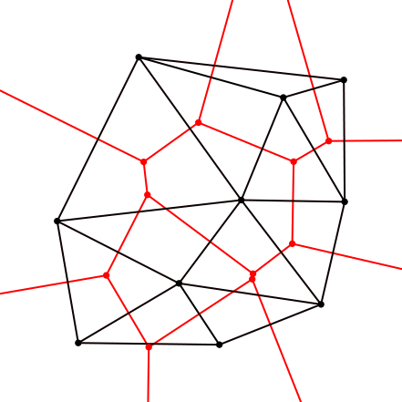
Goals
Accept input vertices
Step through algorithm with human-readable explanations
Allow user to add vertices to completed mesh and see modifications made
Allow user to create new mesh and output as PLY model

Slide 3
Example Video
https://www.youtube.com/watch?v=jZUWxT1Jk_Y

Slide 4
Questions?

